Slide 1


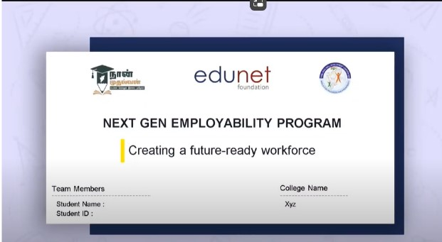
NEXT GEN EMPLOYABILITY PROGRAM
Creating a future-ready workforce
Team Members
College Name
………………………………………...............
………………………………………...............
Student Name : S .Selvadharshini
Student ID : au613021104092
VIVEKANANDHA COLLEGE OF TECHNOLOGY FOR WOMEN

Slide 2
CAPSTONE PROJECT SHOWCASE
Project Title
Notes Sharing Web Application using Django Framework
Abstract | Problem Statement | Project Overview | Proposed Solution | Technology Used | Modelling & Results | Conclusion

Slide 3
Next Gen Employability Program
Abstract
This project focuses on developing a robust and scalable notes sharing web application using Python and Django. With an emphasis on user experience and collaboration, the platform enables seamless creation, sharing, and discussion of notes among individuals and groups. Through integration with popular productivity tools and cloud services, users can access their notes from anywhere, ensuring continuity and accessibility of learning resources.

Slide 4
Next Gen Employability Program
Problem Statement
Access Control and Permissions : Implement access control and permission management functionalities, allowing users to control who can view, edit, and share their notes, ensuring privacy and data security.

Slide 5
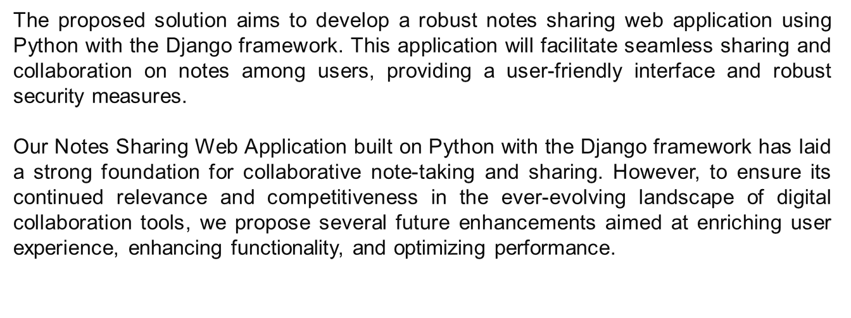
Next Gen Employability Program
Project Overview

Slide 6
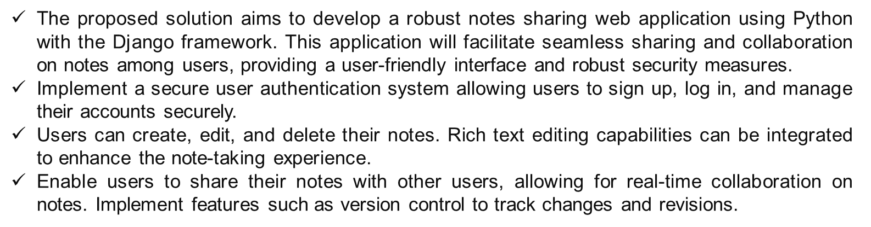
Next Gen Employability Program
Proposed Solution

Slide 7
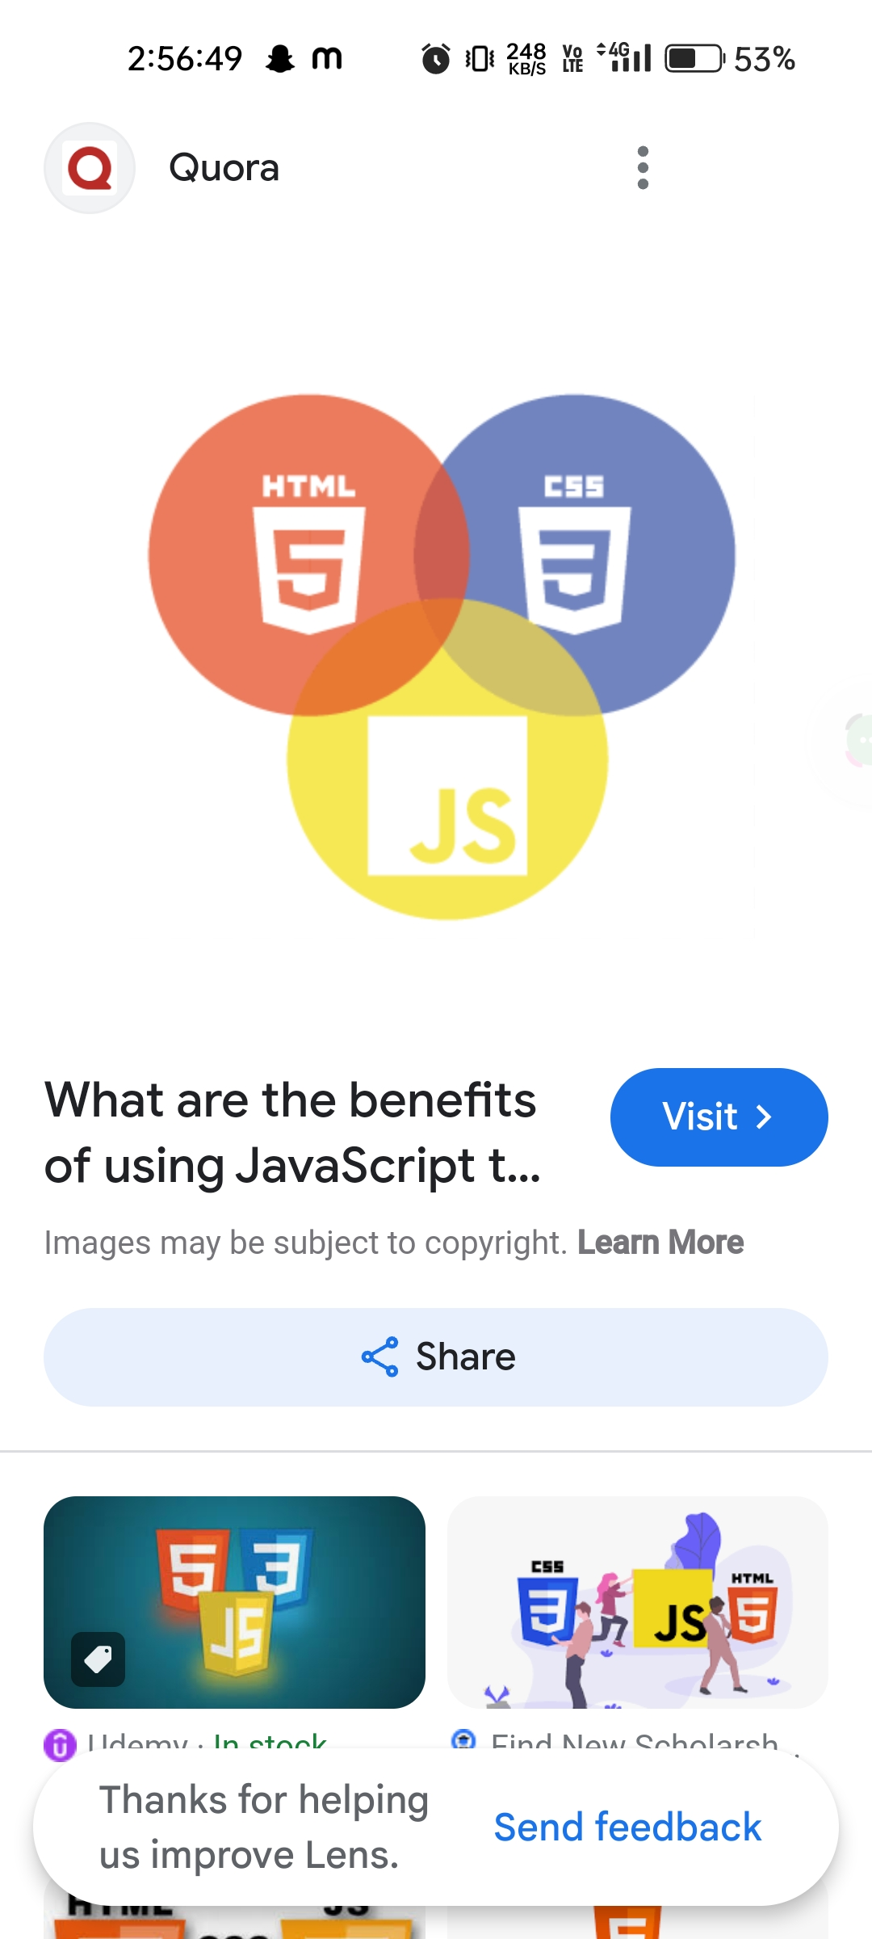
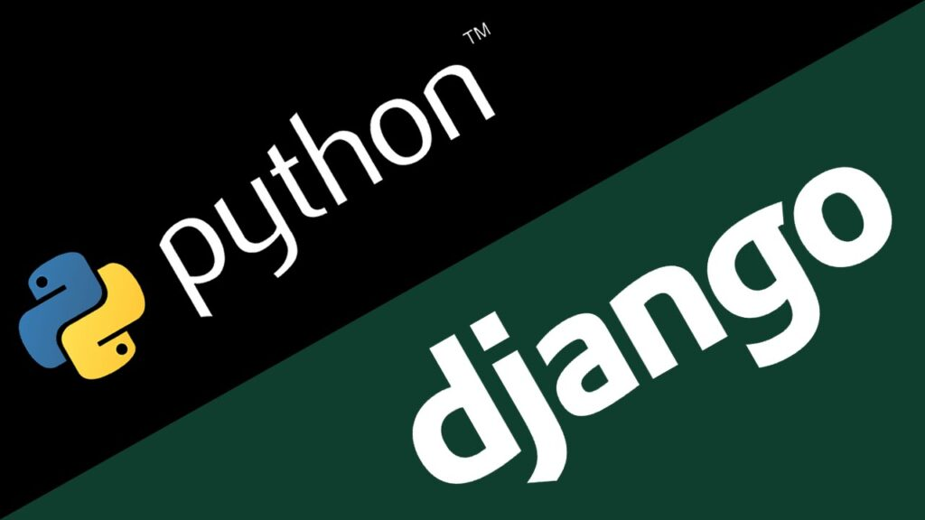
Next Gen Employability Program
Technologies Used
Frontend
Backend

Slide 8
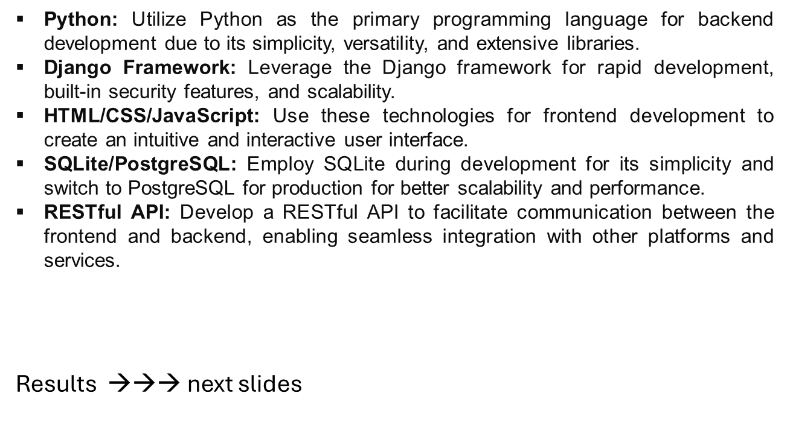
Next Gen Employability Program
Modelling & Results

Slide 9
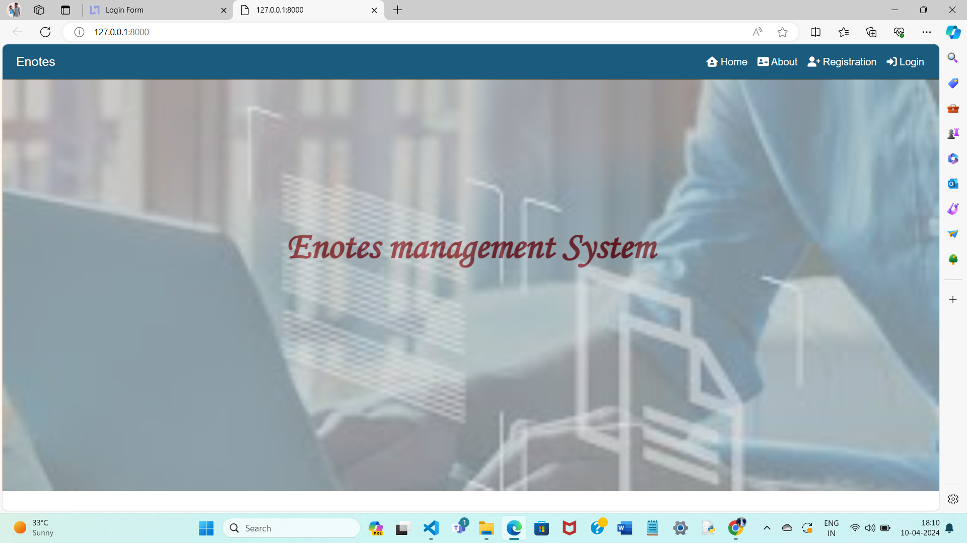
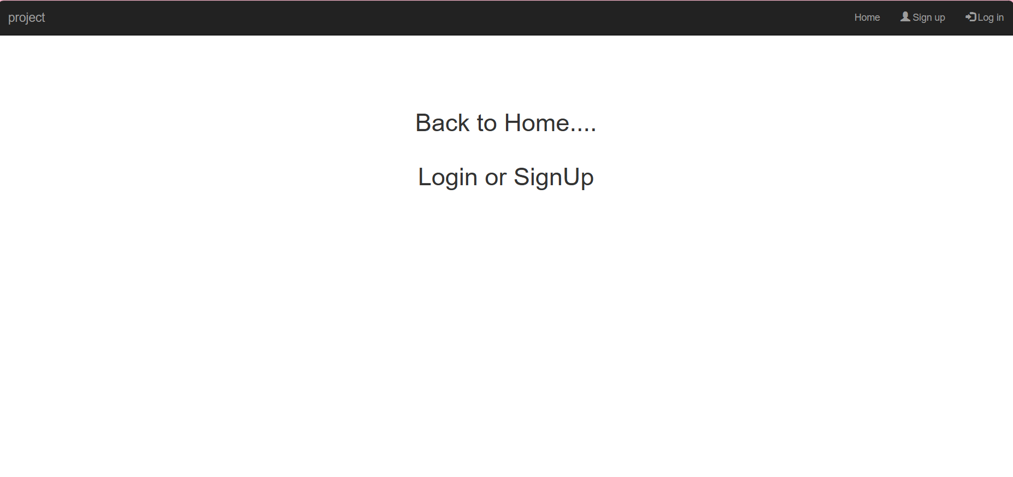
Next Gen Employability Program
Home Page

Slide 10
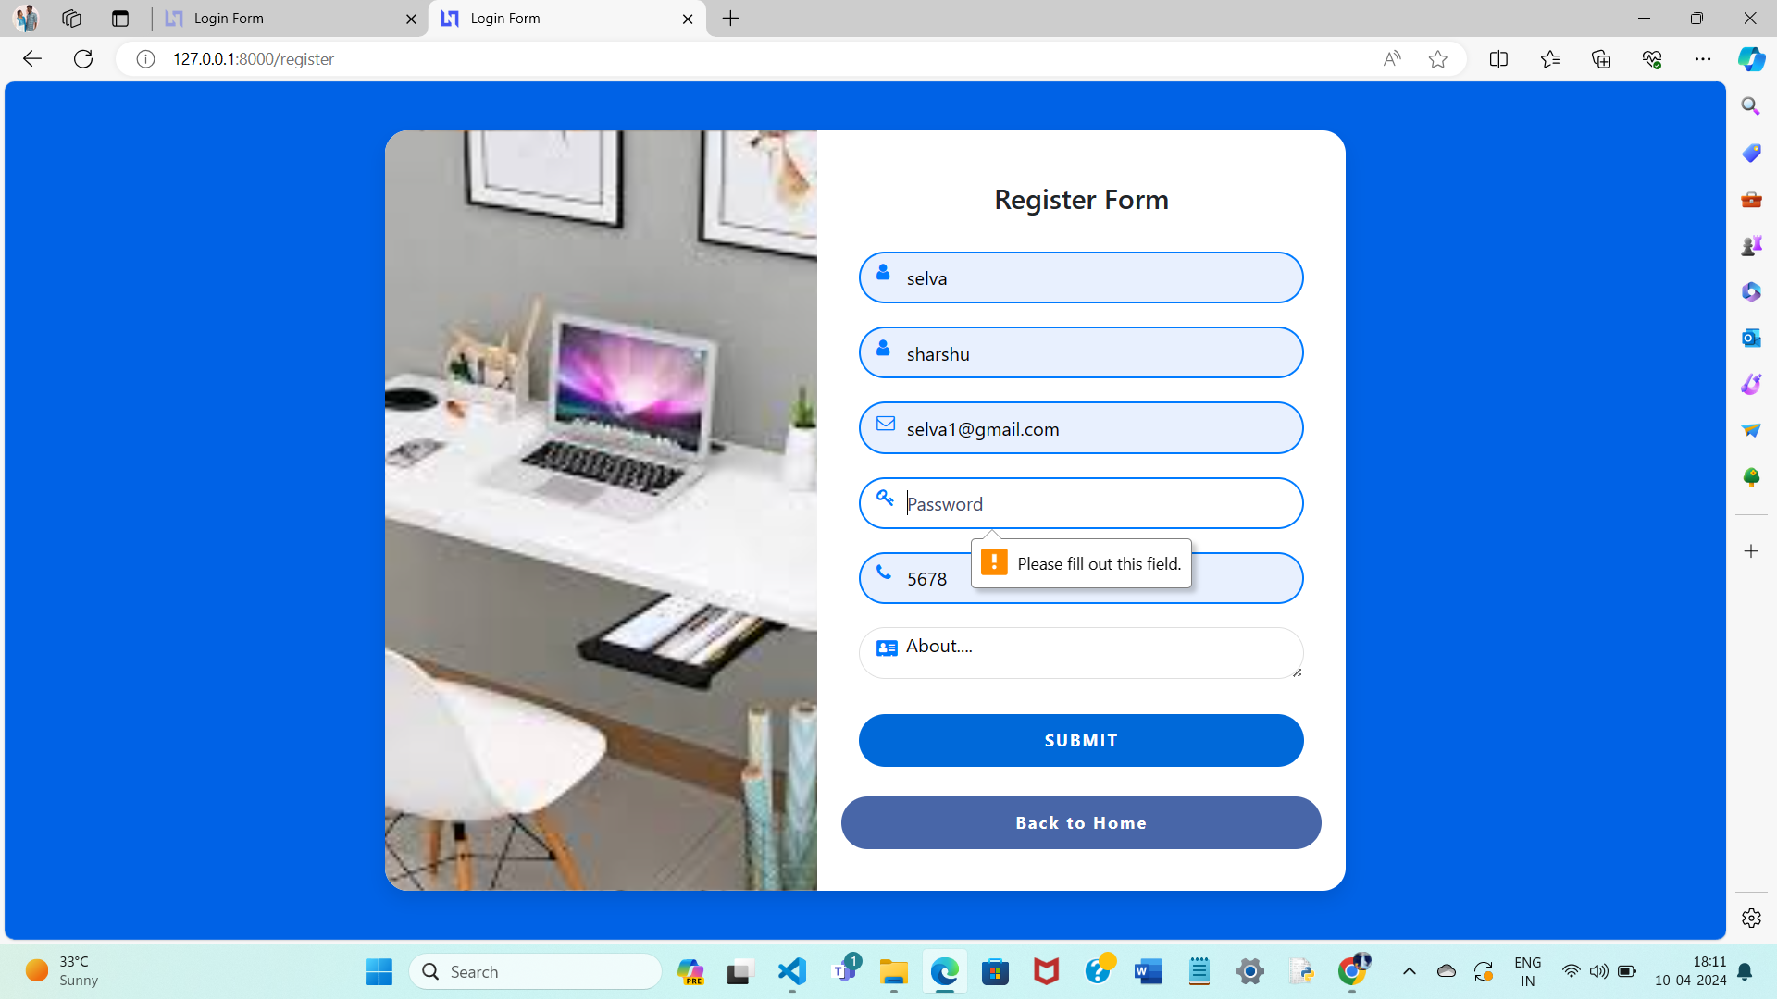
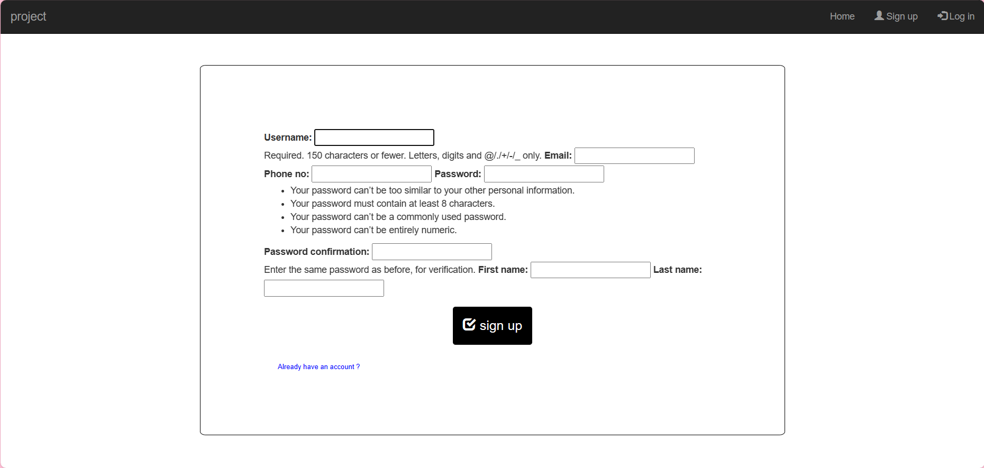
Next Gen Employability Program
SignUp Page

Slide 11
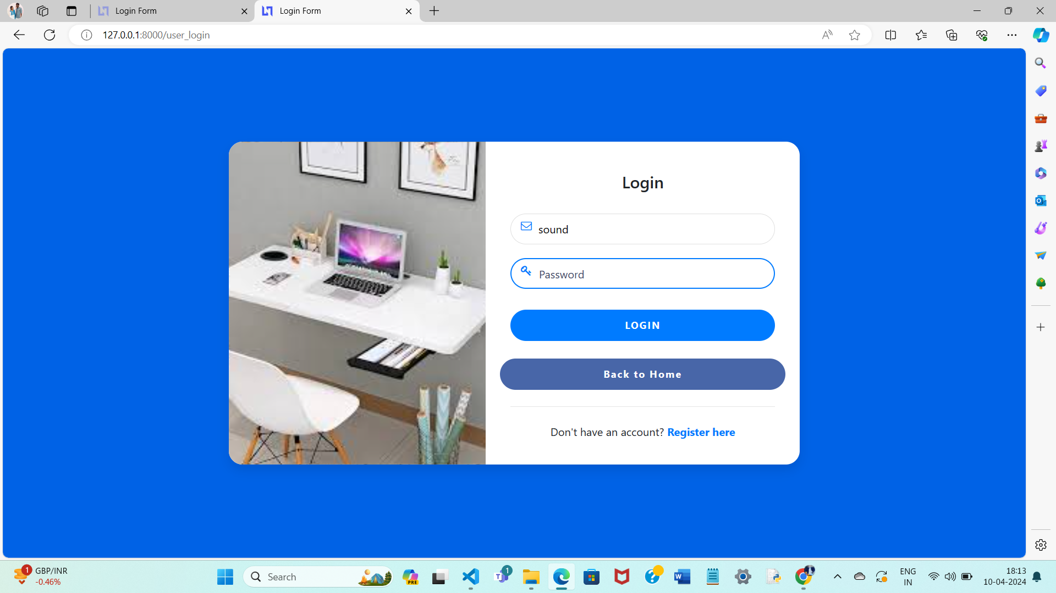
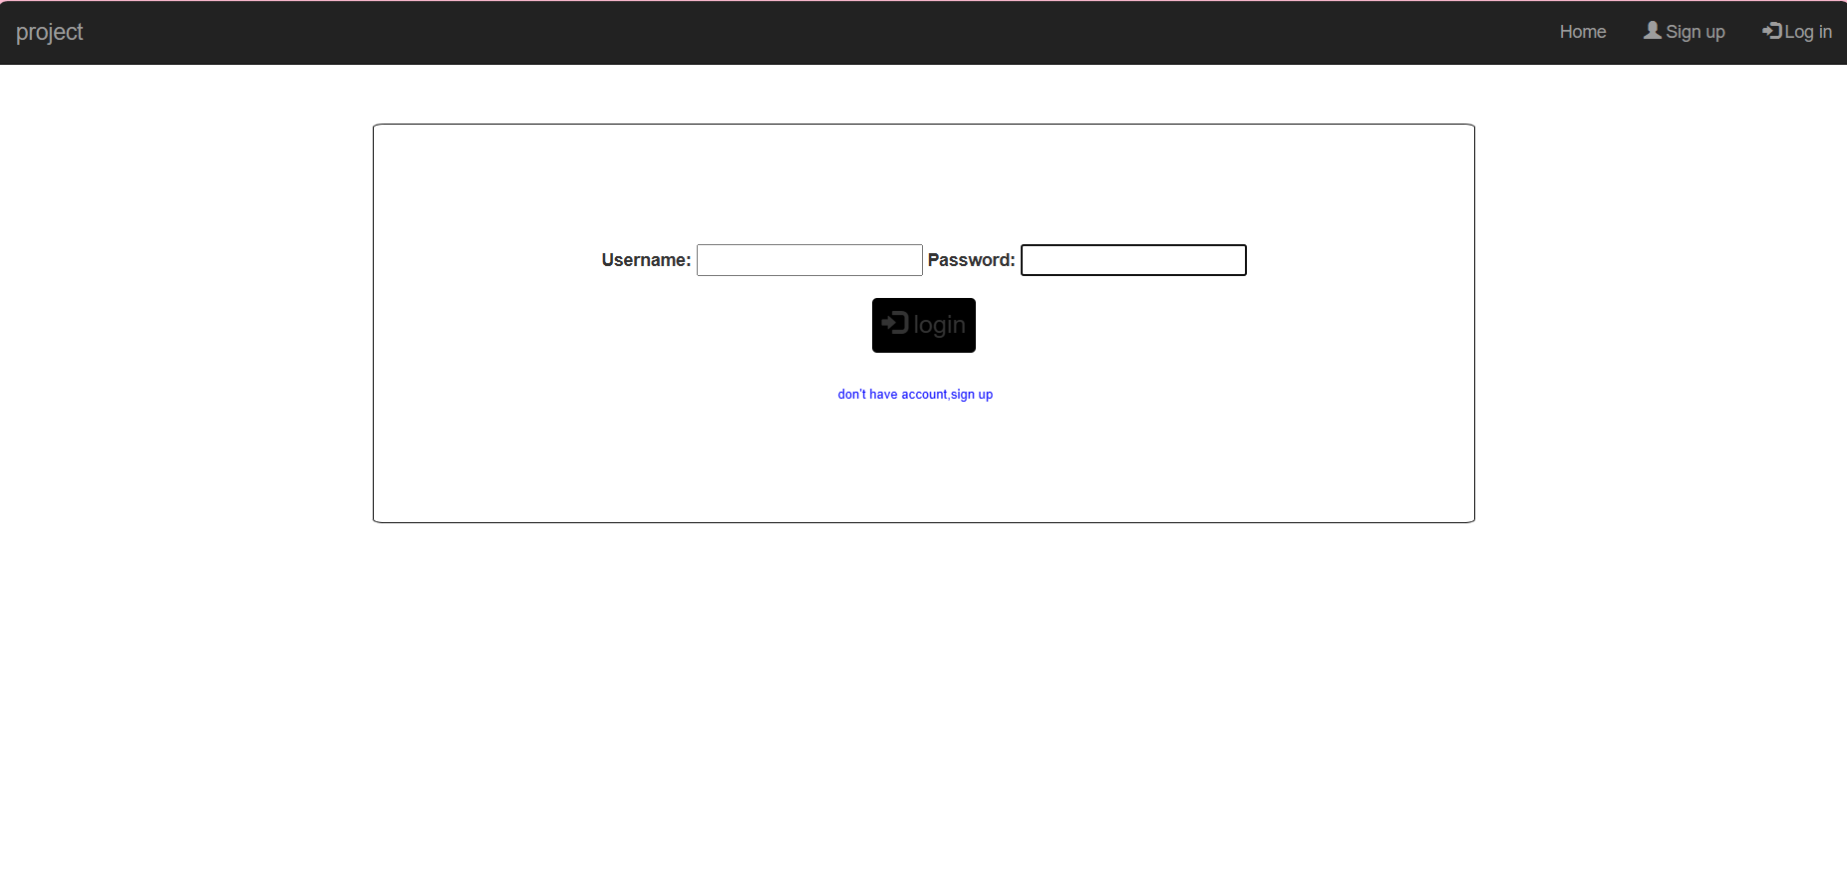
Next Gen Employability Program
Login Page

Slide 12
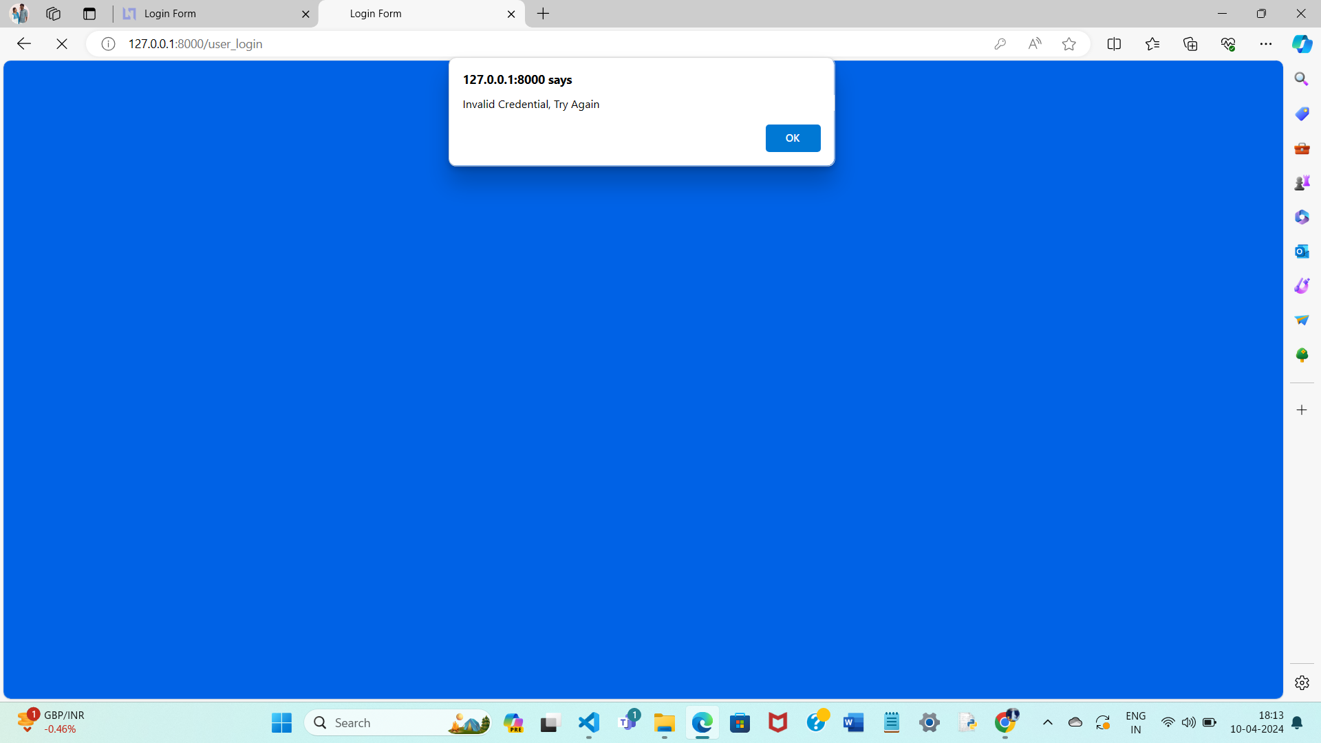
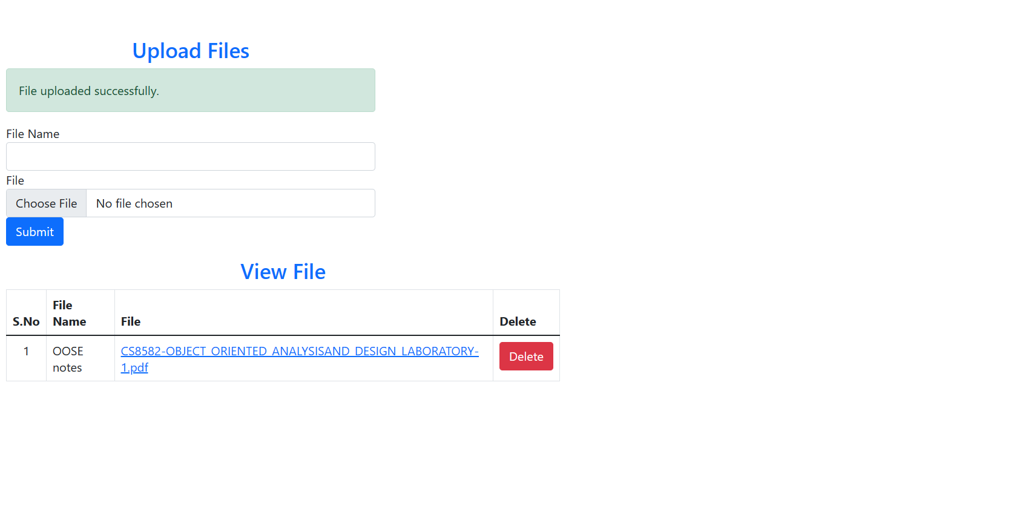
Next Gen Employability Program
Files Uploading Page

Slide 13
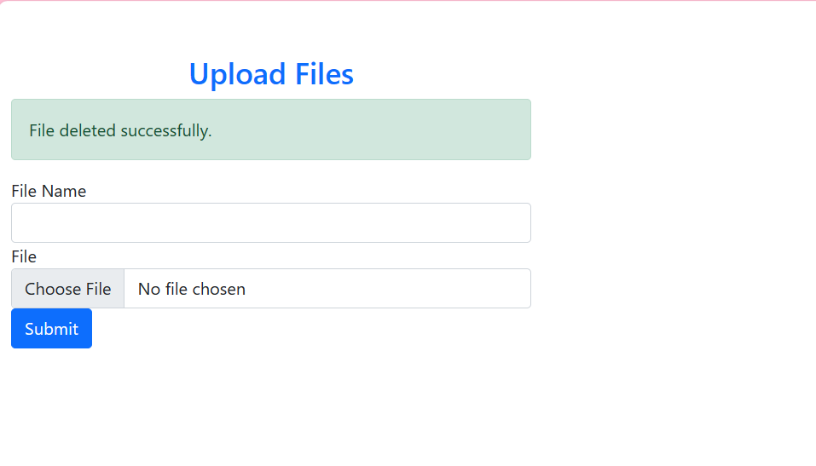
Next Gen Employability Program
Files Deleting Page

Slide 14
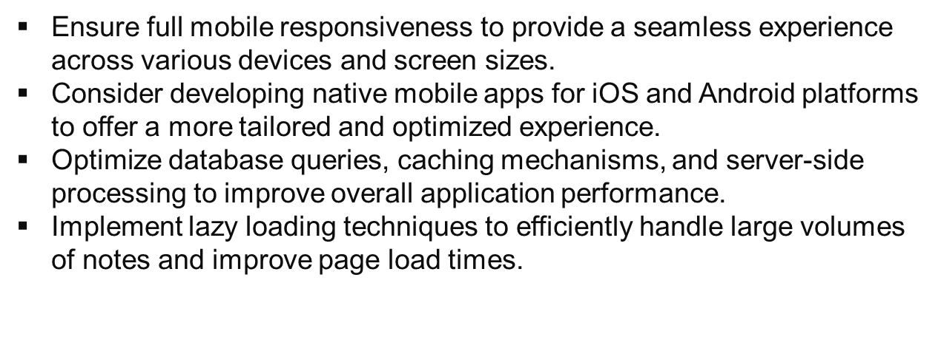
Next Gen Employability Program
Future Enhancements

Slide 15
Next Gen Employability Program
Conclusion
The proposed solution aims to deliver a feature-rich and scalable notes sharing web application that meets the needs of users seeking a platform for collaborative note-taking and knowledge sharing. By leveraging Python with the Django framework and following best practices in software development, the application will provide a seamless and secure user experience while enabling efficient collaboration and productivity.

Slide 16
Next Gen Employability Program
Thank You !

